Slide 1

Network+ Guide to Networks 5th Edition
Chapter 3
Transmission Basics and Networking Media

Slide 2
Objectives
Explain basic data transmission concepts, including full duplexing, attenuation, latency, and noise
Describe the physical characteristics of coaxial cable, STP, UTP, and fiber-optic media
Compare the benefits and limitations of different networking media
Explain the principles behind and uses for serial connector cables
Identify wiring standards and the best practices for cabling buildings and work areas

Slide 3
Network connections
A few slides about connecting network devices together
Cross-over versus straight-through cables

Slide 4
Port Types
Devices on the network are divided into two types:
MDI ports include computer NIC and the Router ports.
MDIX ports include ports of Switch, hub or bridge.

Slide 5
Cross-over versus straight-through cables
Cross-over cables switch the send and receive wires on each end of the cable so that two devices using similar ports can communicate.
Straight-through or patch cables connect the same wires on each side of the cable.
Generally we want to connect similar ports together with crossover cables and opposing ports together with straight-through cables.

Slide 6
Auto-MDIX
Auto-MDIX is a technology developed by HP by Dan Dove and Bruce Melvin.
This technique allows the device to auto-detect the cable type being used and change its port type from MDI to MDIX as required so that it can properly connect using that cable.
To use this, one of the devices must have Auto-MDIX enabled and the connection speed must be set to auto.

Slide 7
Auto-MDIX
Therefore, you must verify this before attempting to connect devices using this technology.
If you have doubts about the equipment or the setup, then using the proper cabling is still the recommended strategy to avoid possible connection problems.

Slide 8
Transmission Basics
Chapter 3

Slide 9
Transmission Basics
Transmit
Issue signals along network medium
Transmission
Process of transmitting
Signal progress after transmitted
Transceiver
Transmit and receive signals

Slide 10
Analog and Digital Signaling
Important data transmission characteristic
Signaling type: analog or digital
Volt
Electrical current pressure
Electrical signal strength
Directly proportional to voltage
Signal voltage
Signals
Current, light pulses, electromagnetic waves

Slide 11
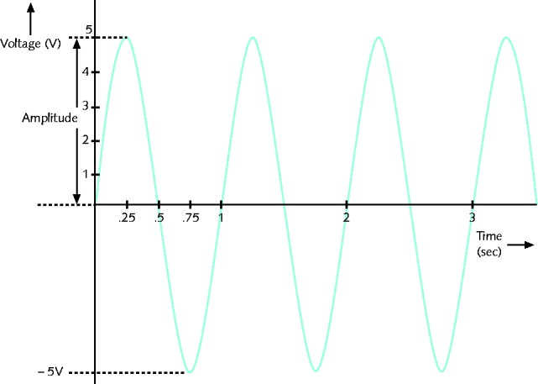
Figure 3-1: An example of an analog signal
Analog data signals
Voltage varies continuously
Properties
Amplitude, frequency, wavelength, phase

Slide 12
Analog and Digital Signaling (cont’d.)
Amplitude
Analog wave’s strength
Frequency
Number of times amplitude cycles over fixed time period
Measure in hertz (Hz)
Wavelength
Distance between corresponding wave cycle points
Inversely proportional to frequency
Expressed in meters or feet

Slide 13
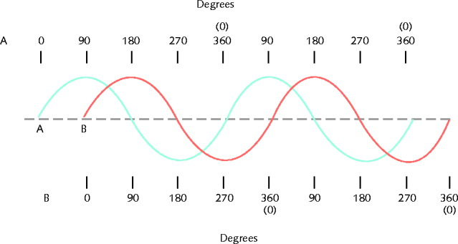
Figure 3-2: Waves with a 90-degree phase difference
Phase
Wave’s progress over time in relationship to fixed point

Slide 14
Analog and Digital Signaling (cont’d.)
Analog signal benefit over digital
More variable
Convey greater information with less energy
Drawback of analog signals
Varied and imprecise voltage
Susceptible to transmission flaws
Digital signals
Pulses of voltages
Positive voltage represents a 1
Zero voltage represents a 0

Slide 15
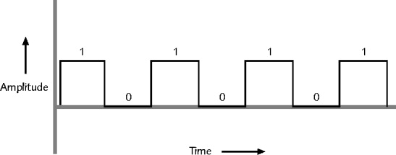
Figure 3-3 An example of a digital signal
Binary system
1s and 0s represent information
Bit (binary digit)
Possible values: 1 or 0
Digital signal pulse

Slide 16

Figure 3-4 Components of a byte
Byte
Eight bits together
Computers read and write information
Using bits and bytes
Find decimal value of a bit
Multiply the 1 or 0 by 2^{x} (x equals bit’s position)

Slide 17
Analog and Digital Signaling (cont’d.)
Convert byte to decimal number
Determine value represented by each bit
Add values
Convert decimal number to a byte
Reverse the process
Convert between binary and decimal
By hand or calculator

Slide 18
Analog and Digital Signaling (cont’d.)
Digital signal benefit over analog signal
More reliable
Less severe noise interference
Digital signal drawback
Many pulses required to transmit same information
Overhead
Nondata information
Required for proper signal routing and interpretation

Slide 19
Data Modulation
Data relies on digital transmission
Network connection may handle only analog signals
Modem
Accomplishes translation
Modulator/demodulator
Data modulation
Technology modifying analog signals
Make data suitable for carrying over communication path

Slide 20
Data Modulation (cont’d.)
Carrier wave
Combined with another analog signal
Produces unique signal
Transmitted from one node to another
Preset properties
Purpose
Convey information
Information wave (data wave)
Added to carrier wave
Modifies one carrier wave property

Slide 21
Data Modulation (cont’d.)
Frequency modulation
Carrier frequency modified
By application of data signal
Amplitude modulation
Carrier signal amplitude modified
By application of data signal

Slide 22
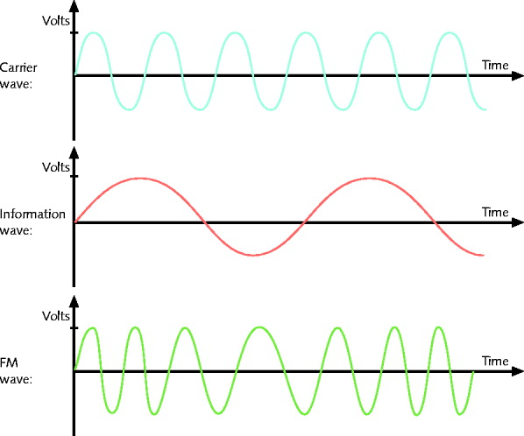
Figure 3-5 Carrier wave modified through frequency modulation

Slide 23
Simplex, Half-Duplex, and Duplex
Simplex
Signal transmission: one direction
Half-duplex transmission
Signal transmission: both directions
One at a time
One communication channel
Shared for multiple nodes to exchange information
Full-duplex
Signals transmission: both directions simultaneously
Used on data networks

Slide 24
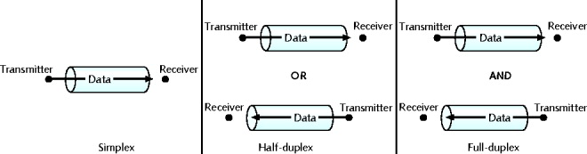
Figure 3-6 Simplex, half-duplex, and full duplex transmission
Channel
Distinct communication path between nodes
Separated physically or logically
Full duplex advantage
Increases speed

Slide 25
Multiplexing
Multiplexing
Multiple signals travel simultaneously over one medium
Subchannels
Logical multiple smaller channels
Multiplexer (mux)
Combines many channel signals for transportation over a medium
Demultiplexer (demux)
Separates combined signals at the destination and regenerates them

Slide 26
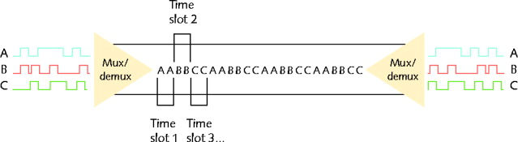
Figure 3-7 Time division multiplexing
TDM (time division multiplexing)
Divides channel into multiple time intervals

Slide 27

Figure 3-8 Statistical multiplexing
Statistical multiplexing
Transmitter assigns slots to nodes according to priority, need
More efficient than TDM

Slide 28
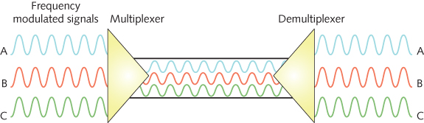
Figure 3-9 Frequency division multiplexing
FDM (frequency division multiplexing)
Unique frequency band for each communications subchannel
Two types
Cellular telephone transmission
DSL Internet access

Slide 29
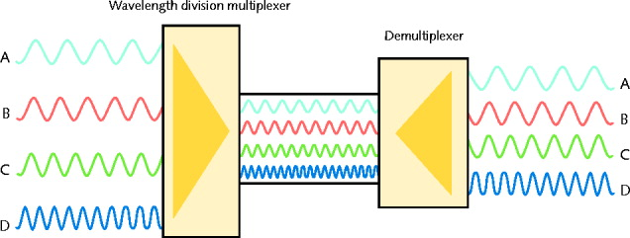
Figure 3-10 Wavelength division multiplexing
WDM (wavelength division multiplexing)
One fiber-optic connection
Carries multiple light signals simultaneously
DWDM (dense wavelength division multiplexing)
Used on most modern fiber-optic networks
Extraordinary capacity

Slide 30
Relationships Between Nodes
Point-to-point transmission
One transmitter and one receiver
Point-to-multipoint transmission
One transmitter and multiple receivers
Broadcast transmission
One transmitter and multiple, undefined receivers
Used on wired and wireless networks
Simple and quick
Nonbroadcast
One transmitter and multiple, defined receivers

Slide 31
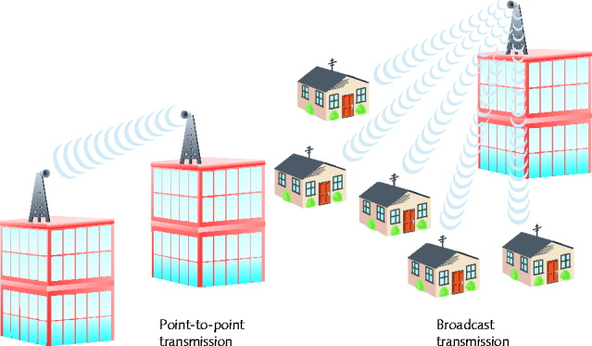
Relationships Between Nodes (cont’d.)
Figure 3-11 Point-to-point versus broadcast transmission

Slide 32
Throughput and Bandwidth
Throughput
Measures amount of data transmitted
During given time period
Capacity or bandwidth
Quantity of bits transmitted per second
Bandwidth (strict definition)
Measures difference between highest and lowest frequencies medium can transmit
Range of frequencies
Measured in hertz (Hz)

Slide 33
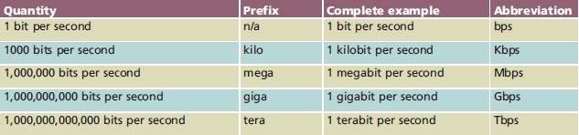
Throughput and Bandwidth (cont’d.)
Table 3-1 Throughput measures

Slide 34
Common media characteristics
Chapter 3

Slide 35
Common Media Characteristics
Selecting transmission media
Match networking needs with media characteristics
Physical media characteristics
Throughput
Cost
Size and scalability
Connectors
Noise immunity

Slide 36
Network Media
Chapter 3

Slide 37
Throughput
Most significant transmission method factor
Causes of limitations
Laws of physics
Signaling and multiplexing techniques
Noise
Devices connected to transmission medium
Fiber-optic cables allows faster throughput
Compared to copper or wireless connections

Slide 38
Cost
Precise costs difficult to pinpoint
Media cost dependencies
Existing hardware, network size, labor costs
Variables influencing final cost
Installation cost
New infrastructure cost versus reuse
Maintenance and support costs
Cost of lower transmission rate affecting productivity
Cost of obsolescence

Slide 39
Noise Immunity
Noise distorts data signals
Distortion rate dependent upon transmission media
Fiber-optic: least susceptible to noise
Limit impact on network
Cable installation
Far away from powerful electromagnetic forces
Select media protecting signal from noise
Antinoise algorithms

Slide 40
Size and Scalability
Three specifications
Maximum nodes per segment
Maximum segment length
Maximum network length
Maximum nodes per segment dependency
Attenuation and latency
Maximum segment length dependency
Attenuation and latency plus segment type

Slide 41
Size and Scalability (cont’d.)
Segment types
Populated: contains end nodes
Unpopulated: No end nodes
Link segment
Segment length limitation
After certain distance, signal loses strength
Cannot be accurately interpreted

Slide 42
Connectors and Media Converters
Connectors
Hardware connecting wire to network device
Specific to particular media type
Affect costs
Installing and maintaining network
Ease of adding new segments or nodes
Technical expertise required to maintain network
Media converter
Hardware enabling networks or segments running on different media to interconnect and exchange signals

Slide 43
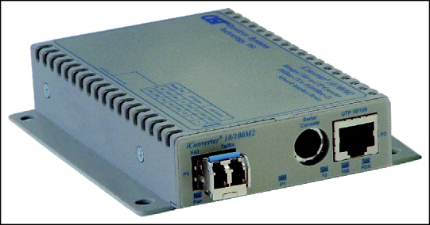
Connectors and Media Converters (cont’d.)
Figure 3-15 Copper wire-to-fiber media converter

Slide 44
Primary Cable Types
Coaxial Cable
Twisted Pair
Unshielded Twisted Pair (UTP)
Shielded Twisted Pair (STP)
Fiber Optics

Slide 45
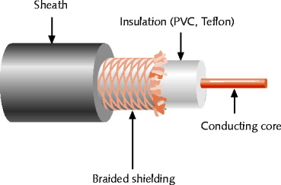
Coaxial Cable
Figure 3-16 Coaxial cable
Central metal core (often copper)
Surrounded by insulator
Braided metal shielding (braiding or shield)
Outer cover (sheath or jacket)

Slide 46
Coaxial Cable (cont’d.)
High noise resistance
Advantage over twisted pair cabling
Carry signals farther before amplifier required
Disadvantage over twisted pair cabling
More expensive
Hundreds of specifications
RG specification number
Differences: shielding and conducting cores
Transmission characteristics

Slide 47
Coaxial Cable (cont’d.)
Conducting core
American Wire Gauge (AWG) size
Data networks usage
RG-6
RG-8
RG-58
RG-59

Slide 48
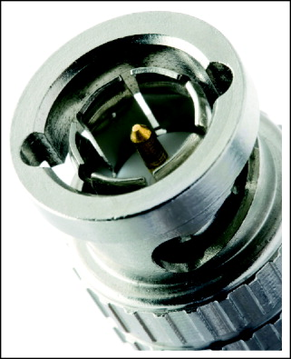
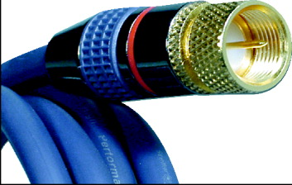
Coaxial Cable (cont’d.)
Figure 3-17 F-type connector
Figure 3-18 BNC Connector

Slide 49
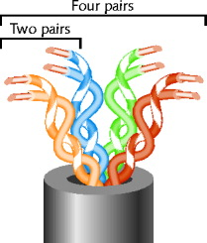
Twisted Pair Cable
Color-coded insulated copper wire pairs
0.4 to 0.8 mm diameter
Encased in a plastic sheath
Figure 3-19 Twisted pair cable

Slide 50
Twisted Pair Cable (cont’d.)
More wire pair twists per foot
More resistance to cross talk
Higher-quality
More expensive
Twist ratio
Twists per meter or foot
High twist ratio
Greater attenuation

Slide 51
Twisted Pair Cable (cont’d.)
Hundreds of different designs
Dependencies
Twist ratio, number of wire pairs, copper grade, shielding type, shielding materials
1 to 4200 wire pairs possible
Wiring standard specification
TIA/EIA 568
Twisted pair wiring types
Cat (category) 3, 4, 5, 5e, 6, and 6e, Cat 7
CAT 5 most often used in modern LANs

Slide 52
Twisted Pair Cable (cont’d.)
Advantages
Relatively inexpensive
Flexible
Easy installation
Spans significant distance before requiring repeater
Accommodates several different topologies
Handles current faster networking transmission rates
Two categories
STP (shielded twisted pair)
UTP (unshielded twisted pair)

Slide 53
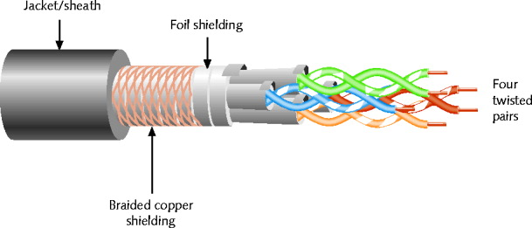
STP (Shielded Twisted Pair)
Individually insulated
Surrounded by metallic substance shielding (foil)
Barrier to external electromagnetic forces
Contains electrical energy of signals inside
May be grounded
Figure 3-20 STP cable

Slide 54
UTP (Unshielded Twisted Pair)
Maximum segment length is 100 meters
Most popular form of LAN cabling
The UTP cable used for networking usually includes one or more pairs of insulated wires
UTP is used for telephony, but requirements for networking uses differ from the telephony ones

Slide 55
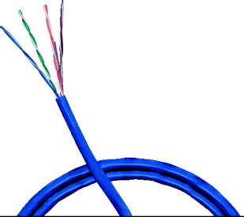
UTP (Unshielded Twisted Pair)
One or more insulated wire pairs
Encased in plastic sheath
No additional shielding
Less expensive, less noise resistance
Figure 3-21 UTP cable

Slide 56
UTP (Unshielded Twisted Pair) (cont’d.)
EIA/TIA standards
Cat 3 (Category 3)
Cat 4 (Category 4)
Cat 5 (Category 5)
Cat 5e (Enhanced Category 5)
Cat 6 (Category 6)
Cat 6e (Enhanced Category 6)
Cat 7 (Category 7)

Slide 57
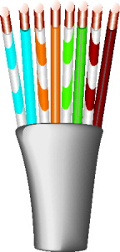
UTP (Unshielded Twisted Pair) (cont’d.)
Figure 3-22 A Cat 5 UTP cable with pairs untwisted

Slide 58
Comparing STP and UTP
Throughput
STP and UTP transmit at the same rates
Cost
STP and UTP vary
Noise immunity
STP more noise resistant
UTP subject to techniques to offset noise
Size and scalability
STP and UTP maximum segment length
100 meters

Slide 59
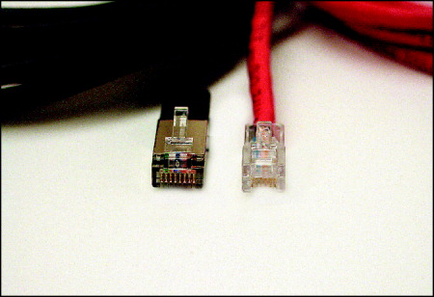
Comparing STP and UTP (cont’d.)
Connector
STP and UTP use RJ-45 (Registered Jack 45)
8 wires in 4 pairs
Telephone connections use RJ-11 (Registered Jack 11)
4 wires in 2 pairs
Figure 3-23 RJ-45 and RJ-11 connectors

Slide 60
Terminating Twisted Pair Cable
Patch cable
Relatively short cable
Connectors at both ends
Proper cable termination techniques
Basic requirement for two nodes to communicate
Poor terminations
Lead to loss or noise
TIA/EIA standards
TIA/EIA 568A
TIA/EIA 568B

Slide 61
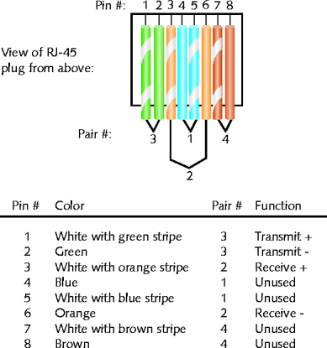
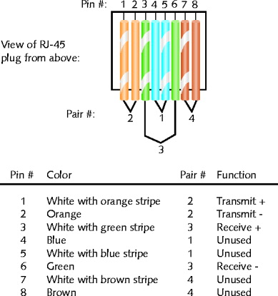
Figure 3-24 TIA/EIA 568A standard terminations
Figure 3-25 TIA/EIA 568B standard terminations

Slide 62
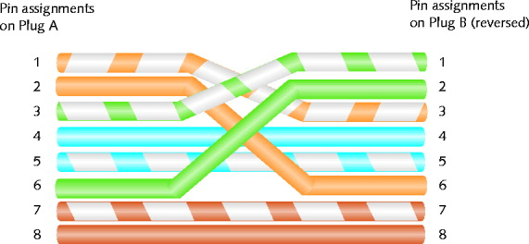
Figure 3-26 RJ-45 terminations on a crossover cable
Straight-through cable
Terminate RJ-45 plugs at both ends identically
Crossover cable
Transmit and receive wires on one end reversed

Slide 63
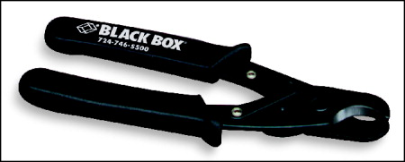
Terminating Twisted Pair Cable (cont’d.)
Figure 3-27 Wire cutter
Termination tools
Wire cutter
Wire stripper
Crimping tool

Slide 64
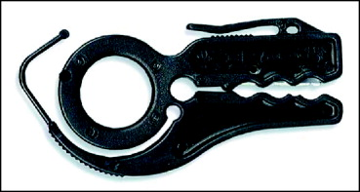
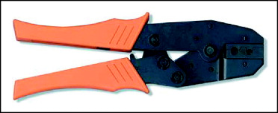
Terminating Twisted Pair Cable (cont’d.)
Figure 3-28 Wire stripper
Figure 3-29 Crimping tool
After making cables
Verify data transmit and receive

Slide 65
Fiber-Optic Cable
Fiber-optic cable (fiber)
One (or several) glass or plastic fibers at its center (core)
Data transmission
Pulsing light sent from laser
LED (light-emitting diode) through central fibers
Cladding
Layer of glass or plastic surrounding fibers
Different density from glass or plastic in strands
Reflects light back to core
Allows fiber to bend

Slide 66
Fiber-Optic Cable (cont’d.)
Plastic buffer
Outside cladding
Protects cladding and core
Opaque
Absorbs any escaping light
Kevlar strands (polymeric fiber) surround plastic buffer
Plastic sheath covers Kevlar strands

Slide 67
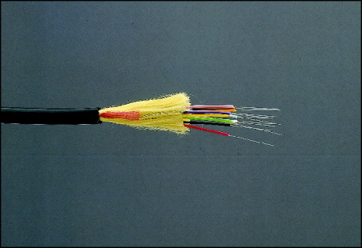
Figure 3-30 A fiber-optic cable
Different varieties
Based on intended use and manufacturer
Two categories
Single-mode
Multimode

Slide 68
SMF (Single-Mode Fiber)
Uses narrow core (< 10 microns in diameter)
Laser generated light travels over one path
Little reflection
Light does not disperse
Accommodates
Highest bandwidths, longest distances
Connects carrier’s two facilities
Cost prohibit typical LANs, WANs use

Slide 69
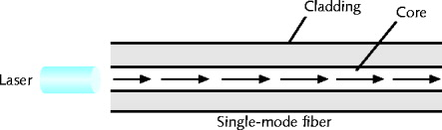
SMF (Single-Mode Fiber) (cont’d.)
Figure 3-31 Transmission over single-mode fiber-optic cable

Slide 70
MMF (Multimode Fiber)
Uses core with larger diameter than single-mode fiber
Common size: 62.5 microns
Laser or LED generated light pulses travel at different angles
Common uses
Cables connecting router to a switch
Cables connecting server on network backbone

Slide 71
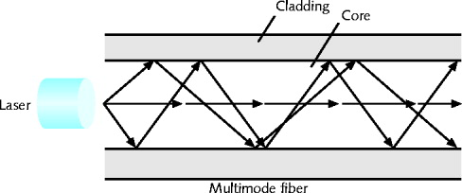
MMF (Multimode Fiber) (cont’d.)
Figure 3-32 Transmission over multimode fiber-optic cable

Slide 72
MMF (Multimode Fiber) (cont’d.)
Benefits
Extremely high throughput
Very high resistance to noise
Excellent security
Ability to carry signals for much longer distances before requiring repeaters than copper cable
Industry standard for high-speed networking
Drawback
More expensive than twisted pair cable
Requires special equipment to splice

Slide 73
MMF (Multimode Fiber) (cont’d.)
Throughput
Reliable transmission rates
Can reach 100 gigabits (or 100,000 megabits) per second per channel
Cost
Most expensive transmission medium
Connectors
ST (straight tip)
SC (subscriber connector or standard connector)
LC (local connector)
MT-RJ (mechanical transfer registered jack)

Slide 74
MMF (Multimode Fiber) (cont’d.)
Noise immunity
Unaffected by EMI
Size and scalability
Segment lengths vary
150 to 40,000 meters
Due primarily to optical loss

Slide 75
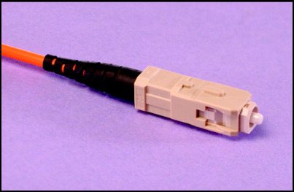
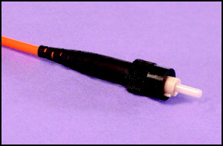
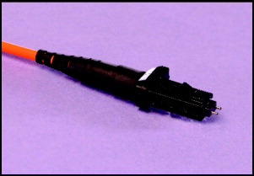
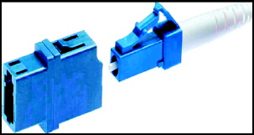
Figure 3-33 ST (straight tip) connector
Figure 3-34 SC (subscriber connector or standard connector)
Figure 3-35 LC (local connector)
Figure 3-36 MT-RJ (mechanical transfer-register jack) connector

Slide 76
DTE (Data Terminal Equipment) and DCE (Data Circuit-Terminating Equipment) Connector Cables
DTE (data terminal equipment)
Any end-user device
DCE (data circuit-terminating equipment)
Device that processes signals
Supplies synchronization clock signal

Slide 77
DTE and DCE Connector Cables (cont’d.)
DTE and DCE connections are:
Serial
Pulses flow along single transmission line
Sequentially
Serial cable
Carries serial transmissions

Slide 78
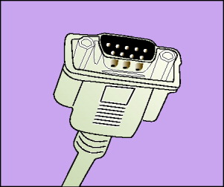
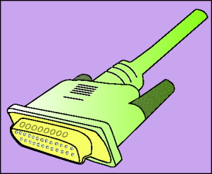
DTE and DCE Connector Cables (cont’d.)
Figure 3-37 DB-9 connector
Figure 3-38 DB-25 connector

Slide 79
DTE and DCE Connector Cables (cont’d.)
RS-232 (Recommended Standard 232)
Serial ports
EIA/TIA standard
Physical layer specification
Signal voltage, timing, compatible interface characteristics
Connector types
RJ-45, DB-9, DB-25
RS-232 connections
Straight-through or crossover

Slide 80
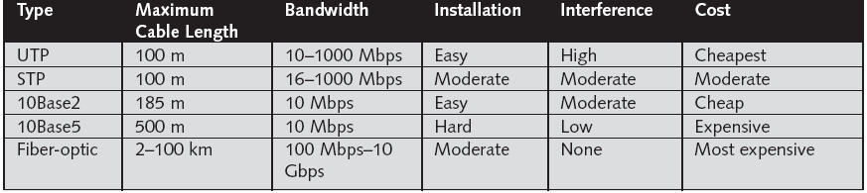
Cable Comparisons

Slide 81
Structured Cabling
Cable plant
Hardware making up enterprise-wide cabling system
Standard
TIA/EIA joint 568 Commercial Building Wiring Standard

Slide 82
Work Area
The work area is where computer workstations and other user devices are located
Faceplates and wall jacks here and patch cables connect computers and printers to wall jacks
Patch cables should be less than 6 meters long
Standard calls for at least one voice and one data outlet on each faceplate in each work area
Connection between wall jack and nearby telecommunications closet made with horizontal wiring

Slide 83
Horizontal Wiring
Runs from the work area’s wall jack to the telecommunications closet and is usually terminated at a patch panel
Acceptable wiring types include four-pair UTP (Category 5e or 6) or two fiber-optic cables
Horizontal wiring from the wall jack to the patch panel should be no longer than 90 meters

Slide 84
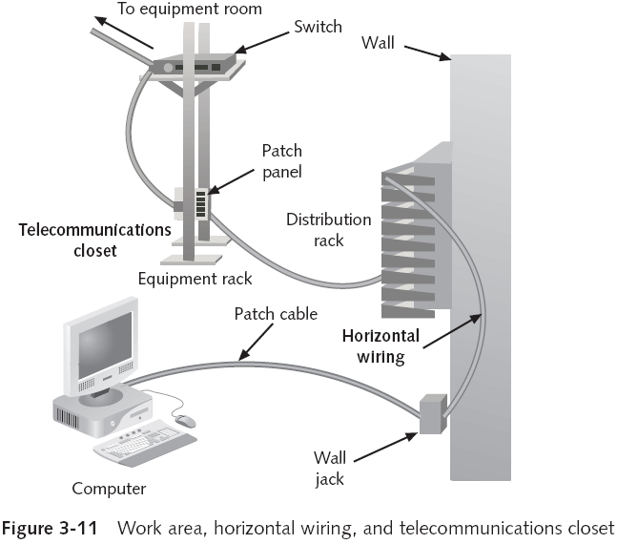
Telecommunications Closet

Slide 85
Equipment Rooms
Houses servers, routers, switches, and other major network equipment, and serves as a connection point for backbone cabling
Can be the main cross-connect of backbone cabling for the network, or it might serve as the connecting point for backbone cabling between buildings

Slide 86
Backbone Cabling
Interconnects TCs and equipment rooms
Runs between floors or wings of a building and between buildings
Frequently fiber-optic cable but can also be UTP

Slide 87
Entrance Facilities
Location of the cabling and equipment that connects a corporate network to a third-party telecommunications provider
Can serve as an equipment room and the main cross-connect for all backbone cabling

Slide 88
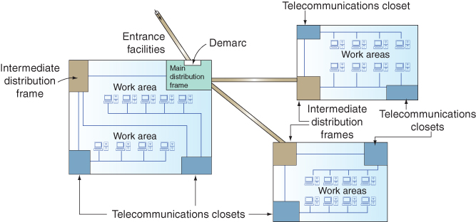
Figure 3-39 TIA/EIA structured cabling in an enterprise

Slide 89
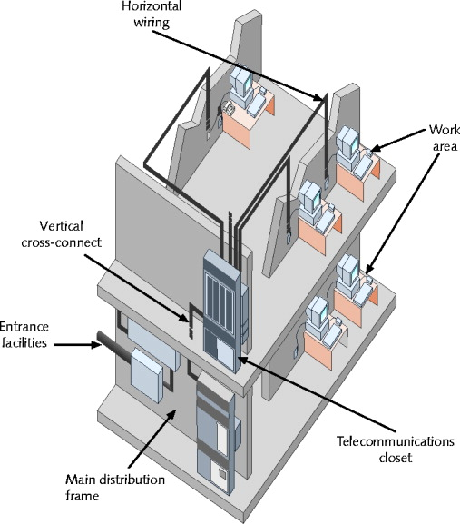
Figure 3-40 TIA/EIA structured cabling in a building

Slide 90
Structured Cabling (cont’d.)
Components
Entrance facilities
MDF (main distribution frame)
Cross-connect facilities
IDF (intermediate distribution frame)
Backbone wiring
Telecommunications closet
Horizontal wiring
Work area

Slide 91
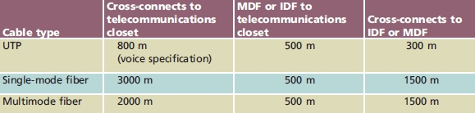
Structured Cabling (cont’d.)
Table 3-2 TIA/EIA specifications for backbone cabling

Slide 92
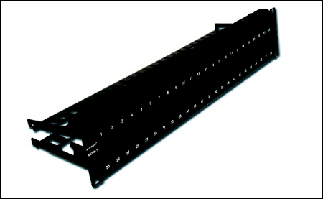
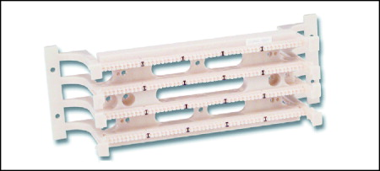
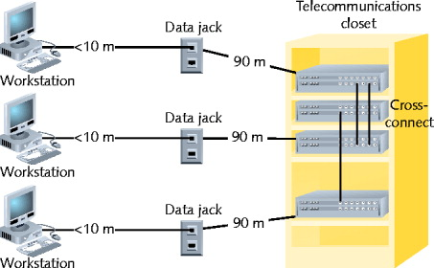
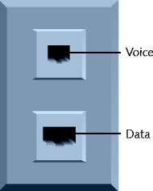
Figure 3-42 Patch panel
Figure 3-41 Patch panel
Figure 3-44 A standard TIA/EIA outlet
Figure 3-43 Horizontal wiring

Slide 93
Best Practices for Cable Installation and Management
Choosing correct cabling
Follow manufacturers’ installation guidelines
Follow TIA/EIA standards
Network problems
Often traced to poor cable installation techniques

